Slide 1
FA-800 Project Final Report - Combining RL and goals-based investing
Group 14:
Rui Wang
Fangchi Wu
Huijun Wen
Adviser: Cristian Homescu

Slide 2

Combining RL and GOALs-based investing
Project object
Basic concepts&method
Data capture
Process and code
Results
Parameter optimization
Conclusion and future work

Slide 3
1. Project object
In this project, we are going to explore a reinforcement learning algorithm combining with goal-based investing. We will use the Deep-Q network to identify the signals given by the market and tell the agent what action to take under what circumstances.
We are going to use several stocks to test our algorithm and perfect our parameters.
Different people have different opinions on investing. Some people do not consider the risk and want to make as much money as possible. However, some people prefer stable returns and reduce risks as much as possible. So, we are going to use the concept of goal-based learning to make our algorithm popularization.
We are going to use different stocks and set different goals to test our algorithm and measure the result.

Slide 4
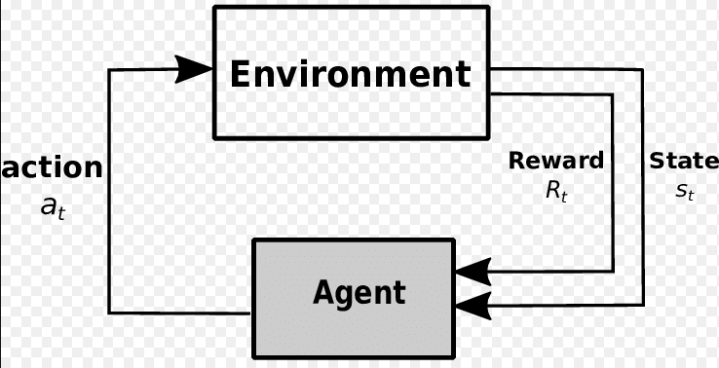
2. Basic concept
Reinforcement learning:
RL is an area of machine learning concerned with how software agents ought to take actions in an environment in order to maximize the notion of cumulative reward.
The agent Interacts with its environment in discrete time steps. At each time t, the agent receives the current state and reward . It then chooses an action from the set of available actions, which is subsequently sent to the environment.
The goal in reinforcement learning is to maximize the expected total reward

Slide 5
2. Basic concept
Our policy (Q-learning)
Q -learning (Watkins, 1989) is a simple way for agents to learn how to act optimally in controlled Markovian domains. It amounts to an incremental method for dynamic programming which imposes limited computational demands. It works by successively improving its evaluations of the quality of particular actions at particular states.

Slide 6
2. Basic concept
Goal based investment
Goal based investment involves a wealth manager or investment firm’s clients measuring their progress towards specific life goals rather than focusing on generating the highest possible portfolio return or beating the market.
Most investors are not risk adverse, but rather loss adverse.
However very few people don't care about the risk but only cares about make as much money as possible.
Use risk management method to make different plans for people with different goals.

Slide 7
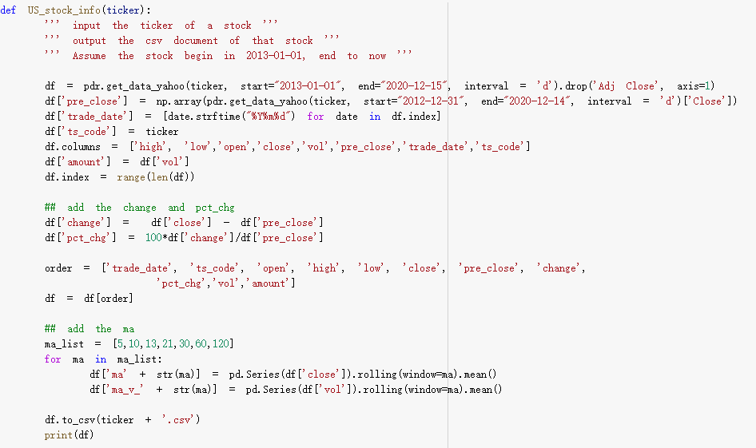
3. Data capture
Use the stock data from 2013 to 2020
Columns we use from the original dataset
Other factors we will use in this project

Slide 8
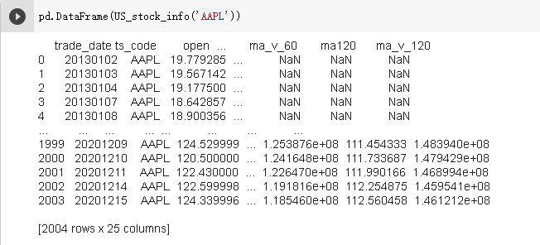
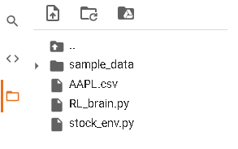
3. Data capture
Contain total 25 columns, 2004 rows. 23 of the columns are using as factors.
The CSV file is also saved in our project folder.

Slide 9
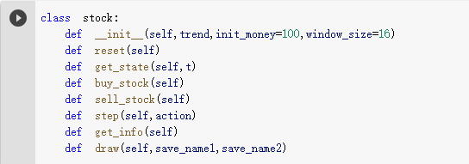
4. Process and codes
Environment
Init - initial money, window size, buy rate, sell rate and so on.
reset - money_hold, buy_num, hold_num, volatility, reward, time t and so on.
get state - state at time t.
buy_stock - buy number, service fee etc.
sell_stock - sell number, service fee etc.
step - record the action buy or sell, collect the rewards.
get_info - get the information of the each state. Include sell, buy and the profit.
draw - draw the graph of the result and compare with the actual movement.

Slide 10
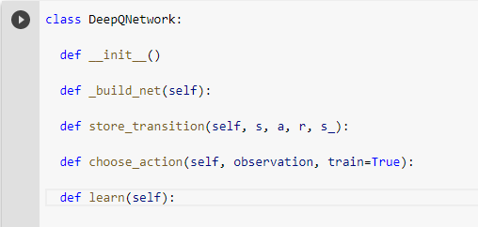
4. Process and codes
Deep Q network
Init - learning step, actions, memory, etc.
Build_net - build evaluate net and target net.
store_transition - replace the old memory with new memory.
choose_action - foward feed the observation and get q value for every actions.
learn - sample batch memory from all memory, change q_target, calculate q_eval's action, and train the eval network.

Slide 11
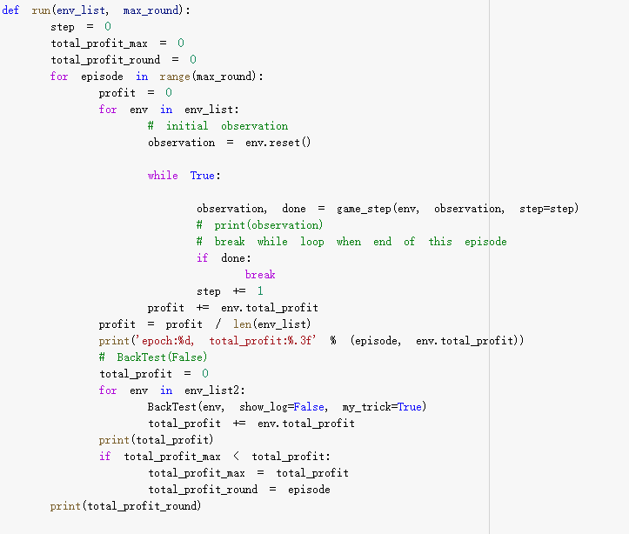
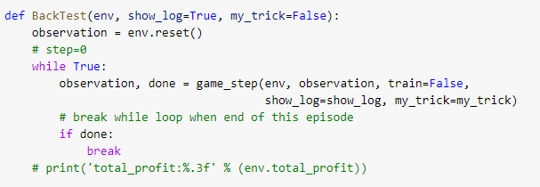
4. Process and codes
Main Program
run():
Input: Stock list, Maximum number of simulations
Output：profit of each time, the final model
BackTest(): Show the backtest results

Slide 12
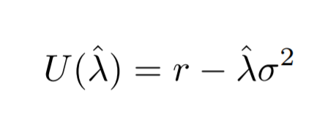
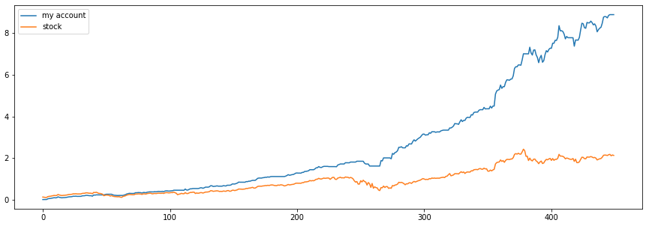
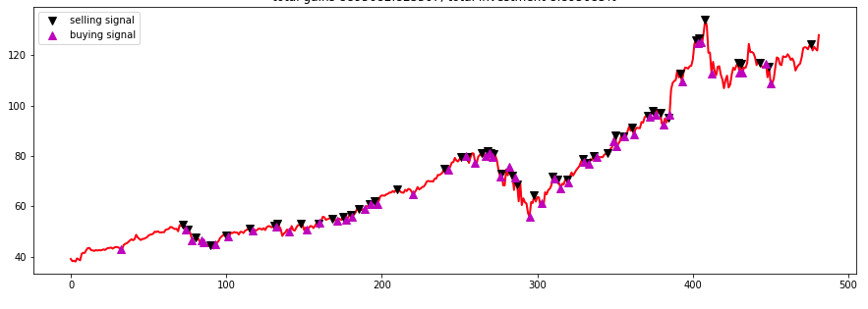
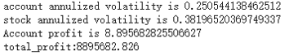
5. Results
Don't care about risk(λ=0)
Goal based target function:
Stock AAPL:

Slide 13
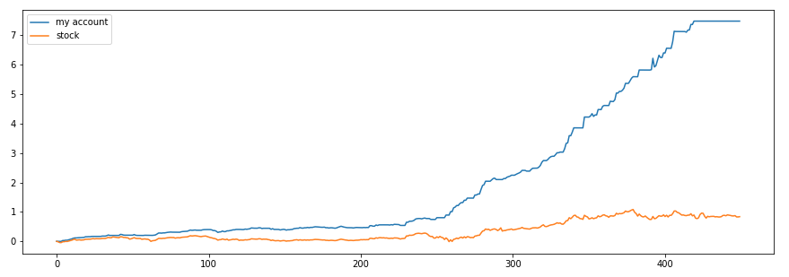
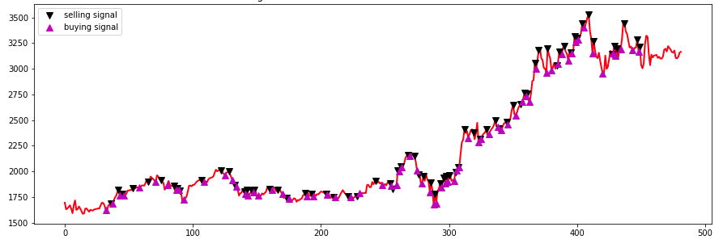
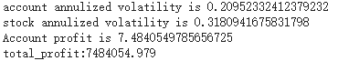
5. Results
Don't care about risk(λ=0)
Stock AMZN:

Slide 14
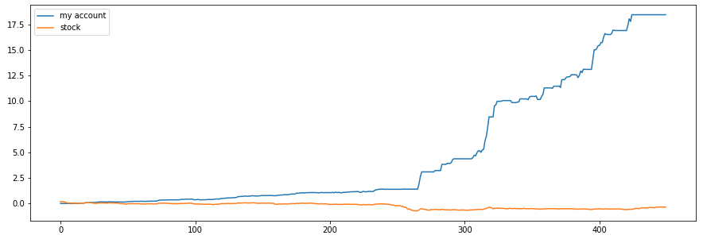
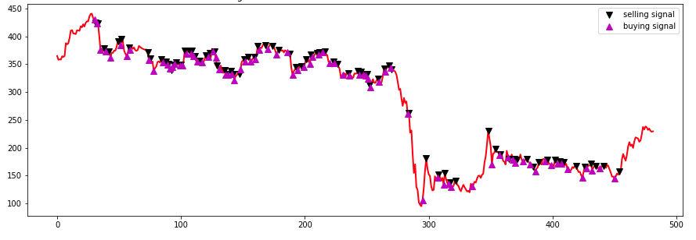
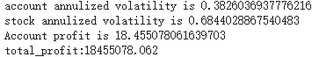
5. Results
Don't care about risk(λ=0)
Stock BA:

Slide 15
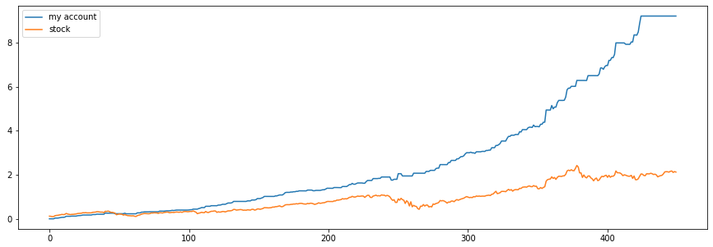
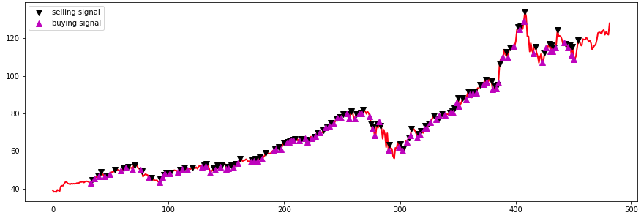
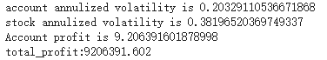
5. Results
Care about risk(λ=10)
Stock AAPL:

Slide 16
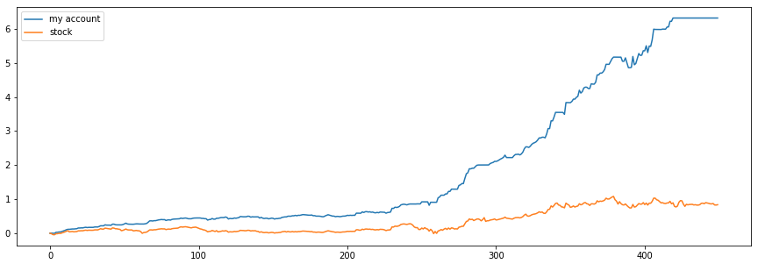
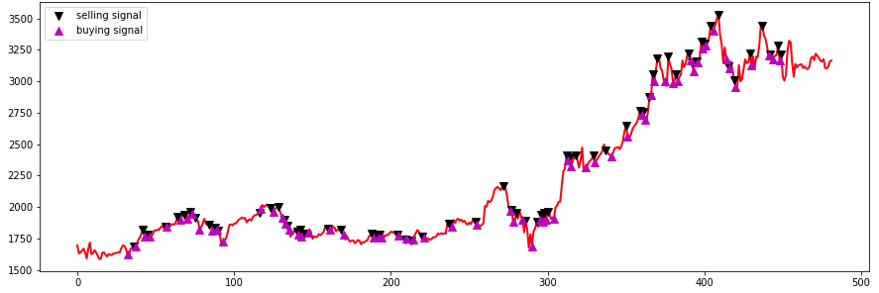
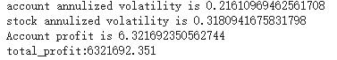
5. Results
Care about risk(λ=10)
Stock AMZN:

Slide 17
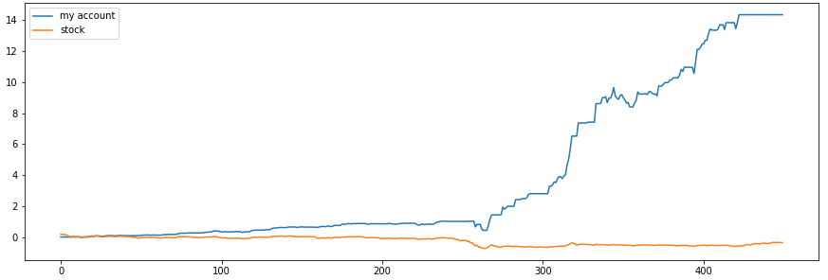
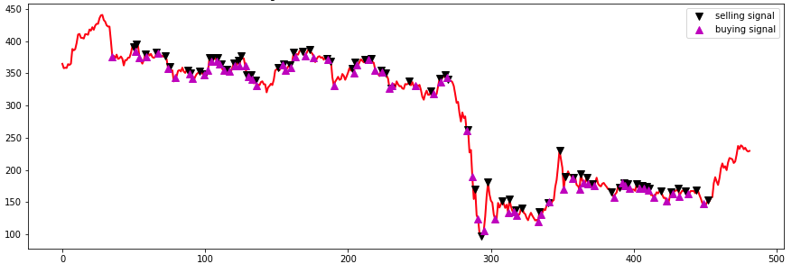
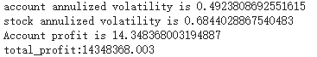
5. Results
Care about risk(λ=10)
Stock BA:

Slide 18
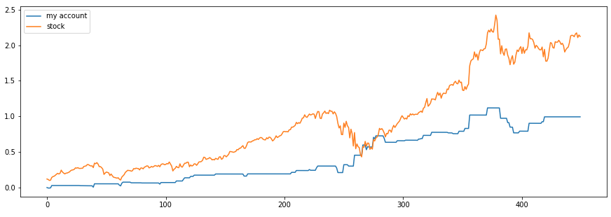
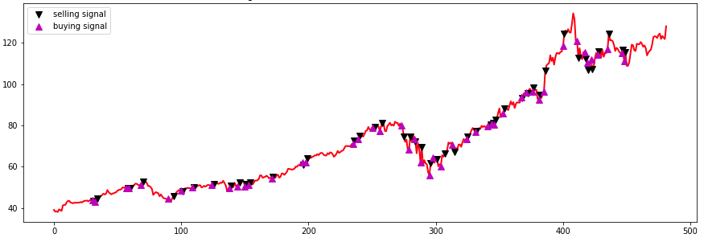
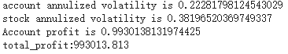
5. Results
Really care about risk(λ=1000)
Stock AAPL:

Slide 19
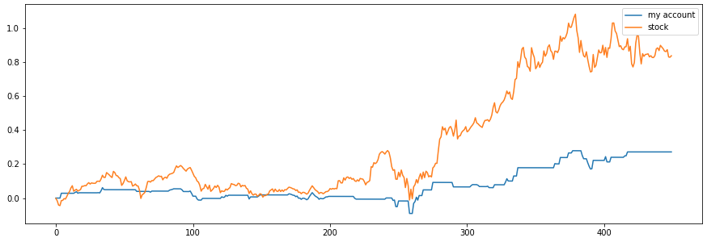
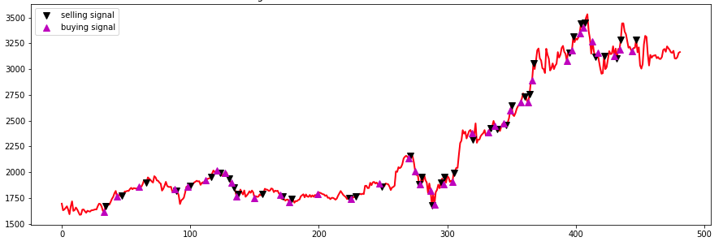
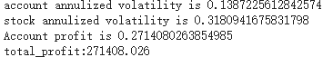
5. Results
Really care about risk(λ=1000)
Stock AMZN:

Slide 20
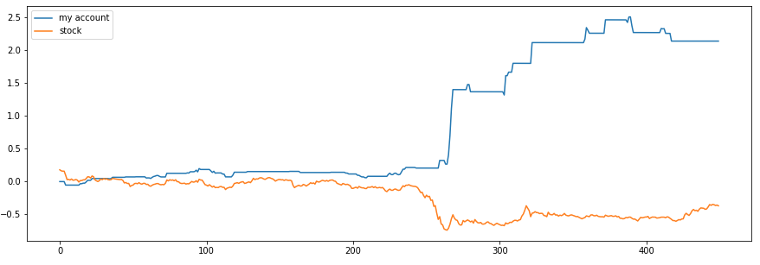
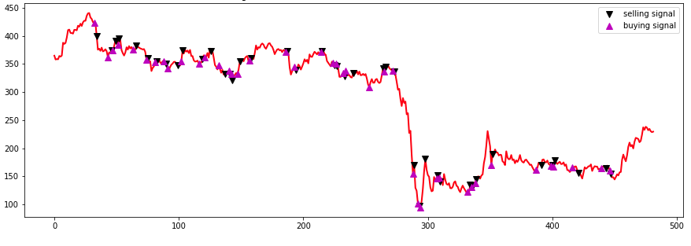
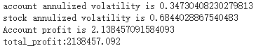
5. Results
Really care about risk(λ=1000)
Stock BA:

Slide 21
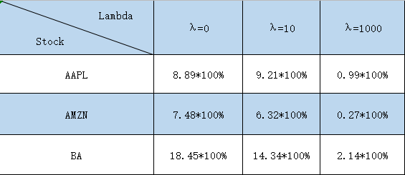
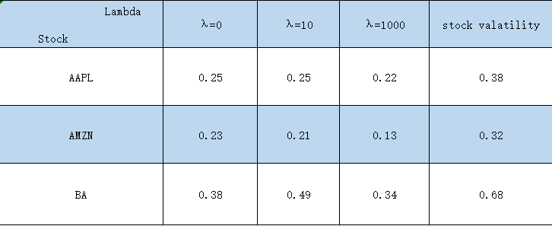
5. Results
Compare the result:

Slide 22
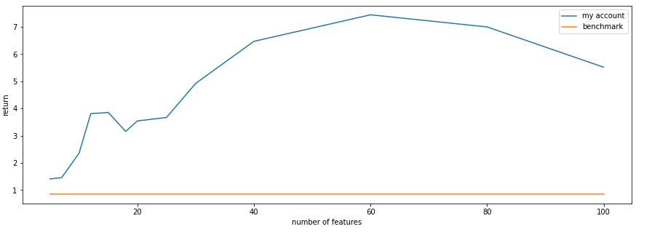
6. OPTIMIZation AND PARAMETER INFLUENCE
Influence by number of features:

Slide 23
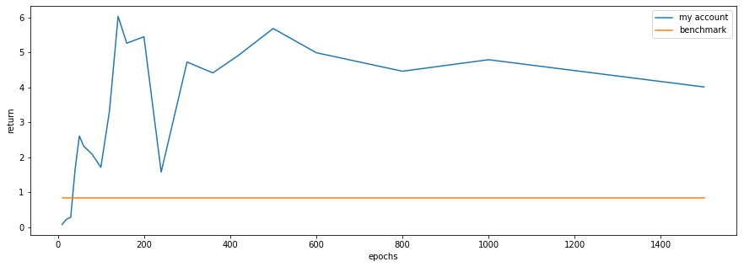
6. OPTIMIZATION AND PARAMETER INFLUENCE
Influence by training epochs:

Slide 24
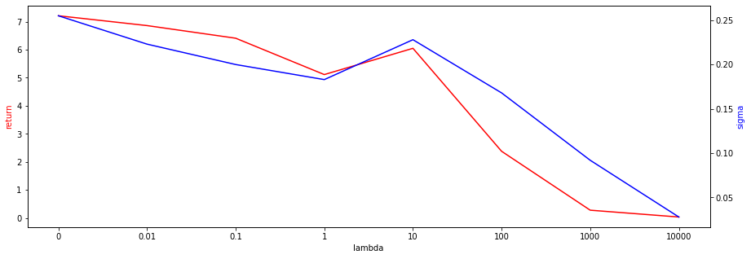
6. OPTIMIZE AND PARAMETER INFLUENCE
Influence by lambda(λ):

Slide 25
7. Conclusion and Future work
1. Like many good models in the market, our model in the test set also greatly magnified the earnings of the U.S. stock market.
2. With adequate training, the trading signals are also very clear, without excessive frequency or sparsity.
3. From the point of view of parameter influence and optimization, the results are also very consistent with the basic behavior pattern of machine learning parameter influence, which changes continuously and generally has extreme value points.
4. After converting a goal-based problem into a utility function, the risk-related problem can be directly determined by a parameter(λ).

Slide 26
7. Conclusion and Future work
1. Real trading or mock trading tests
2. For goal-based problems, add more nonlinear constraints.
3. Optimize for more detailed parameters.
4. Convert the target topic from a single stock to a portfolio

Slide 27
Thank you
Q&A

